Slide 1

Customer Segmentaton Project
Virtual Internship
10/27/2022

Slide 2

Group Name: cust_seg
Specialization: Data Science
Submitted to: Data Glacier
Internship Batch: LISUM 12
Team Member Details:
Brennan Clinch, bclincher98@gmail.com, USA, North Carolina State University, Data Science
Rohit Sunku, rgs8890@gmail.com, UK, Le Wagon, Data Science (Not contributing)
Kutay Selçuk, kutay.selcuk@ozu.edu.tr, Turkey, Ozyegin University, Data Science (Not contributing)
Zhan Shi, zhanshi@g.ucla.edu, USA, University of California Los Angeles, Data Science
Group Information

Slide 3
XYZ bank wants to roll out Christmas offers to their customers. But Bank does not want to roll out the same offer to all customers. Instead, they want to roll out personalized offers to a particular set of customers. If they manually start understanding the category of the customer then this will be not efficient and also they will not be able to uncover the hidden pattern in the data (pattern which group certain kind of customer in one category). Bank approached ABC analytics company to solve their problem. Bank also shared information with ABC analytics that they don't want more than 5 groups as this will be inefficient for their campaign.
ABC analytics assigned this talk to their analytics team and instructed their team to come up with the approach and feature which group similar behavior in one category and others in a different category.
Problem Description

Slide 4
Total Customers: 1000000
Goals:
Since we are interested in segmenting customers into no more than 5 groups, we will first perform EDA on the distributions of products used by the customers along with other demographics to get an idea on recommendations for grouping the customers along with our modeling.
After doing EDA, we will use modeling to identify and group customers using unsupervised learning techniques since we are not dealing with any dependent variables. We will choose at least two techniques and compare results with one another to come up with final recommendations.
Overall Goals

Slide 5
Total Customers: 1000000
Goal: We want to segment customers based on their behavior. The main things we are interested in for our Exploratory Data Analysis are:
What products are most used by the customers?
What channel has the most amount of customers?
What age range has the most customers? Does the age ranges have an effect on the types of products being bought?
What products are most used based on the seniority of the customer from when they started?
Does the city/province of the customer have an effect on the products that are bought or used?
What effect does gender have on the products being bought?
Income by city, age, seniority, and gender.
Goals for EDA

Slide 6

From the table below, we see that channel “KAT” is the most popular channel being used by the customers.
EDA: Channel Distribution
Table of the 10 most popular channels being used

Slide 7
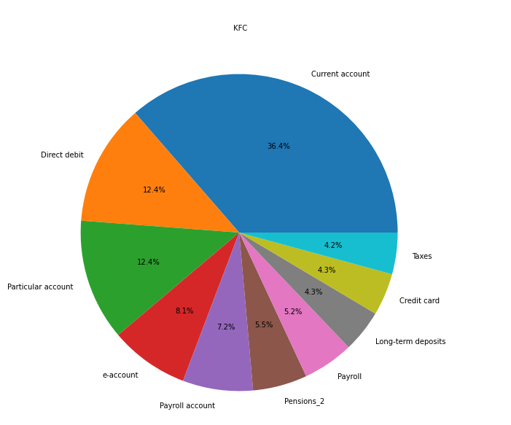
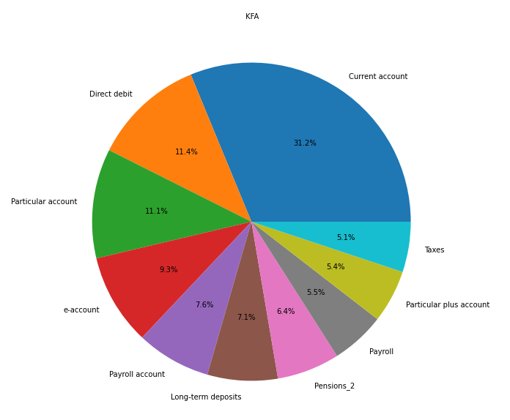
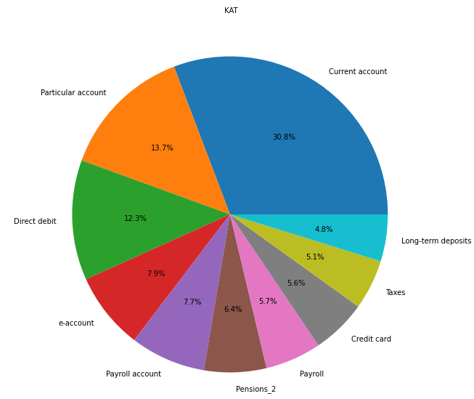
For the distribution of products based on channel, we can see that for the top 3 channels that take up the most amount of data, there is no significant difference of products between customers.
EDA: Products by Channel Distribution

Slide 8
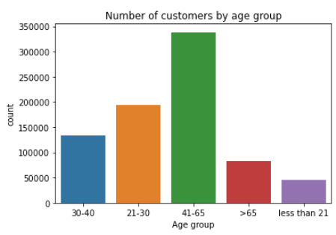
For the general customer distribution, people aged 41-65 make up the biggest portion of total customers.
EDA: Age Distribution

Slide 9
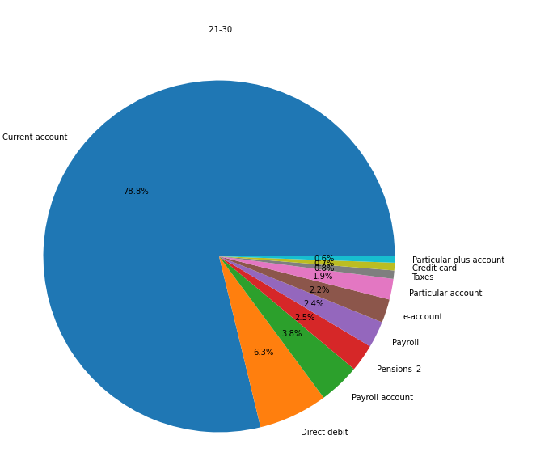
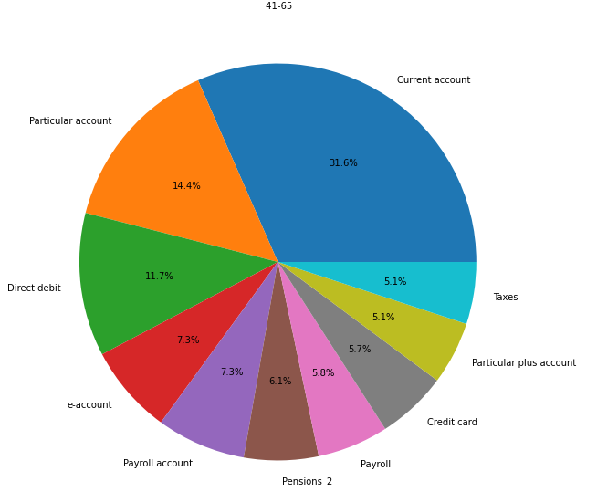
However, customers who are young adults (under 21 and 21-30) make up the biggest proportion of purchases with a Current Account compared to those aged 41-65.
Also, not shown here, but a Junior Account is a popular product used by those who are under 21.
EDA: Product Distribution
by Age
41-65
21-30

Slide 10
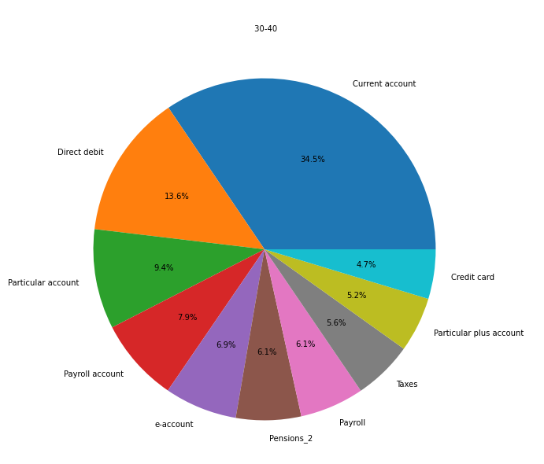
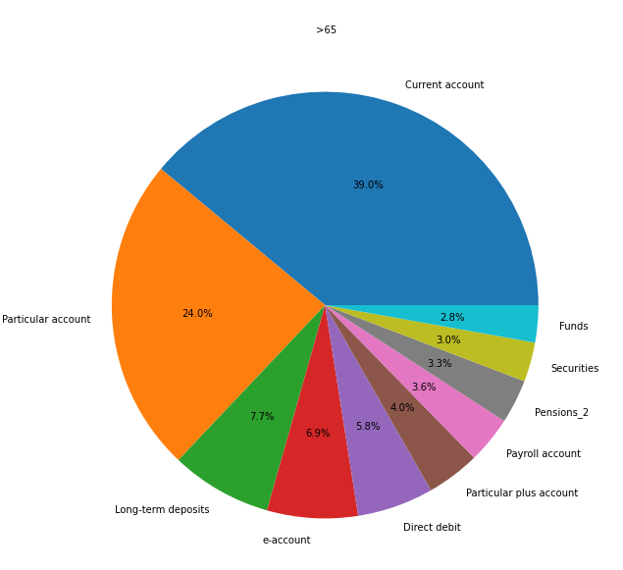
For customers who are over 65, the other most popular account for them is Particular account.
Direct debit is popular among individuals aged 30-40.
EDA: Product Distribution by Age
30-40
> 65

Slide 11
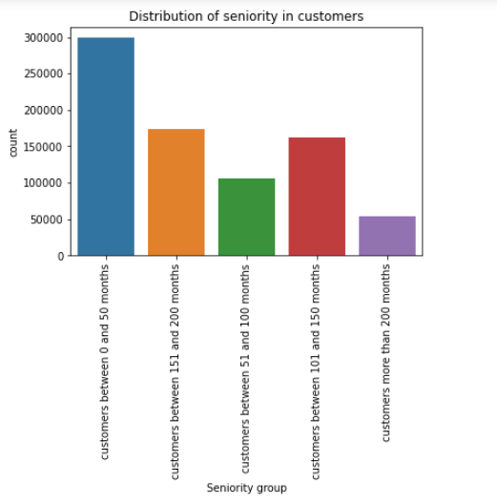
Most customers are brand new, meaning they have been there less than 50 months (or 4 years).
The next popular groups are those who have been at company between 100 and 200 months.
EDA: Seniority of customers

Slide 12
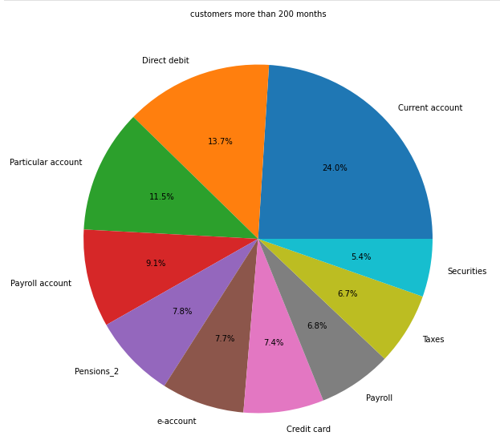
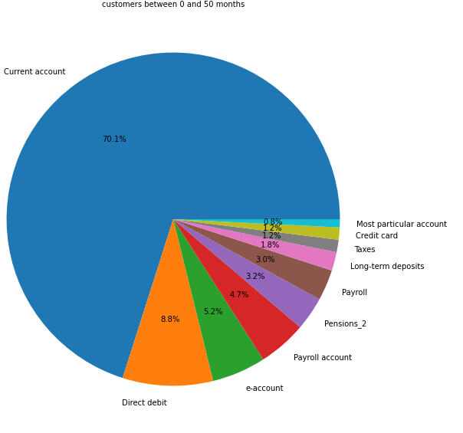
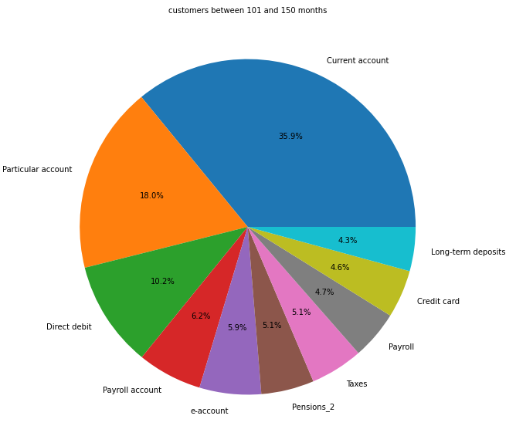
The amount of customers who have a current account decreases as the time they have been a member increases.
Customers who have been there 4 years or less are most likely to have a Current Account.
> 200 months
101 and 150 months
EDA: Product Distribution by Seniority
0 and 50 months (~4 years)

Slide 13
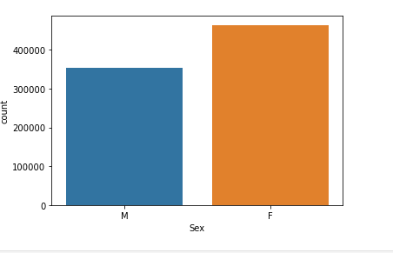
Overall, females are the most popular customer gender.
EDA: Customers by Gender

Slide 14
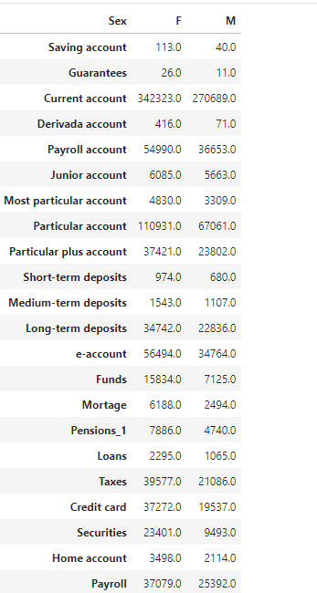
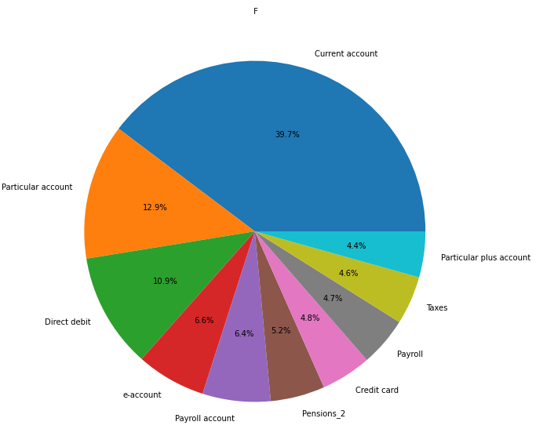
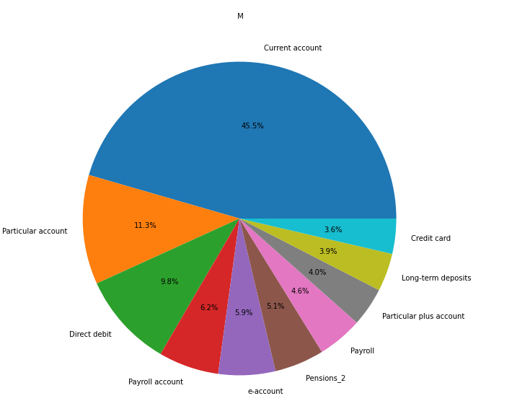
Overall, females have more products than males, but although the difference isn’t significant, there are a little bit more males that have a Current account than females.
EDA: Product Distribution by Gender
Females
Males

Slide 15
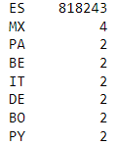
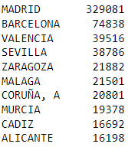
Based on the tables below, we can see that almost all customers are from Spain, along with Madrid being the most popular city/province.
Top countries of customers
Top 10 cities of customers
EDA: Customers by Country and City

Slide 16
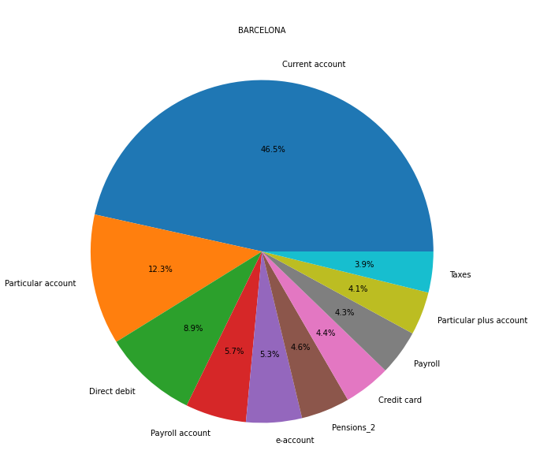
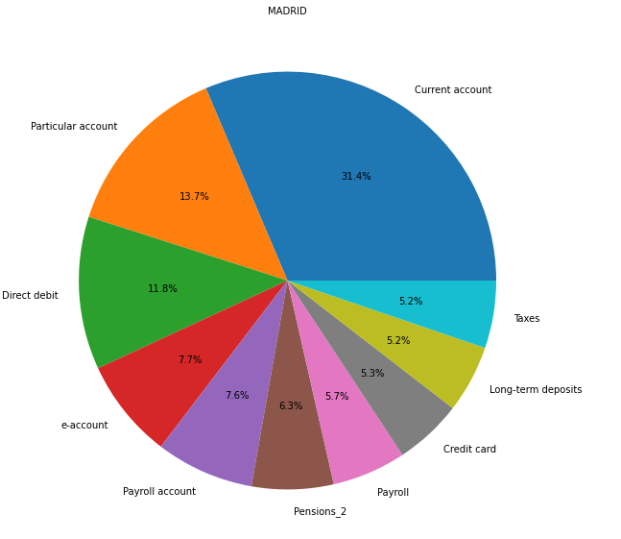
Based on the pie charts, we can see that the city/province can have a significant effect on the product distributions from customers.
EDA: Customer Distribution by City
Barcelona
Madrid

Slide 17
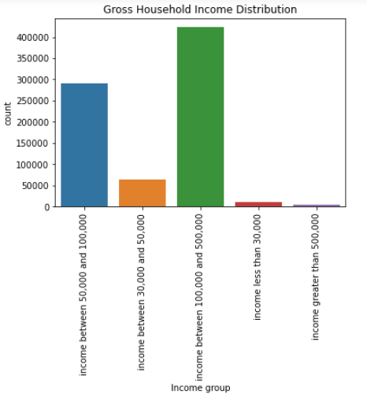
From the bar graph, we can see that customers usually make between $100,000 and $500,000.
EDA: Customers by income

Slide 18
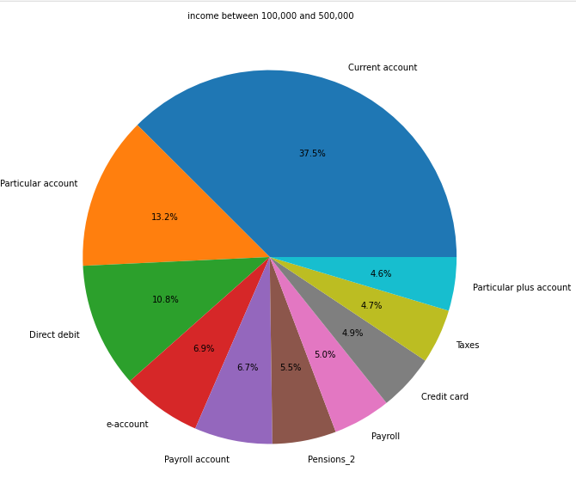
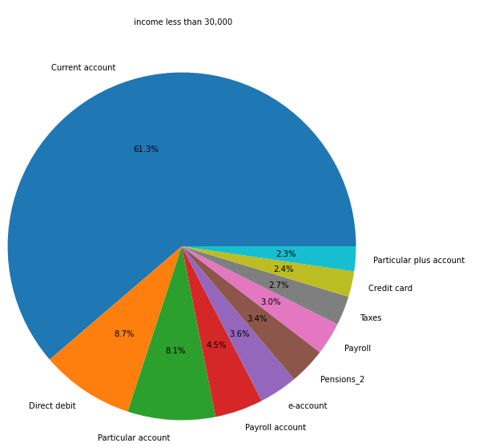
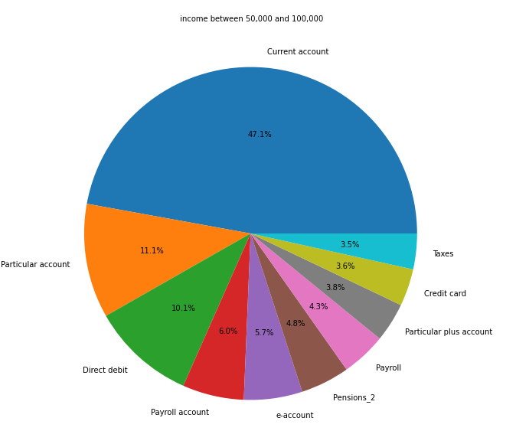
Based on the pie charts, we can conclude that there is a significant difference between the product distributions based on the gross income of customers.
Income between $100k and $500k
EDA: Product Distribution by Income
Income less than $30k
Income between $50k and $100k

Slide 19
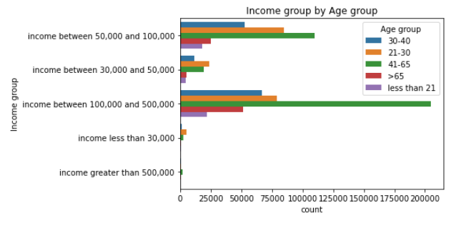
Customers who are young adults (21-30) are most likely to have a gross household income of between $50,000 and $100,000.
Customers who are middle aged (41-65) are more likely to have a gross household income greater than $100,000 but less than $500,000. This would most likely make sense as this age group has been working for a while.
EDA: Income by Age Group

Slide 20
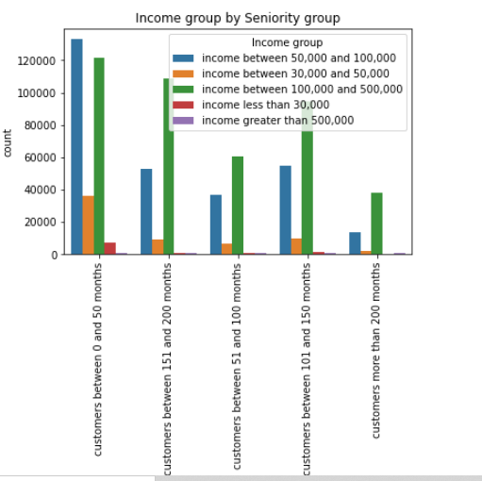
Customers who have gross household income between $50,000 and $100,000 most likely have been a customer for less than 4 years, along with those who have income between $100,000 and $500,000.
EDA: Income by Seniority

Slide 21
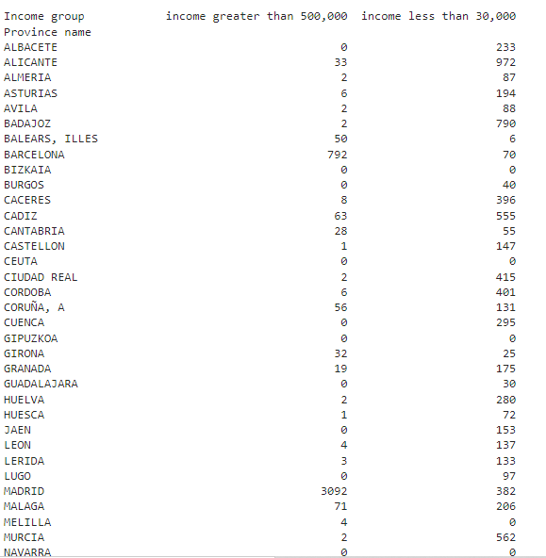
Overall, Madrid was the most popular city by customers for most income groups. However, it was shown that for customers whose gross household income was less than $30,000, other cities had a higher number of customers.
EDA: Income by City

Slide 22
Since we will be working with no dependent variables, we will use unsupervised learning methods for our modeling.
Since we are wanting to divide customers into different groups that share similar product and other demographic behavior in order to break up the groups for special Christmas offers, we will most likely be using clustering, which is when we divide data points up into a certain number of groups so that the data points in same group are similar to the other data points in same group than other groups.
We will use two different types of clustering methods, shown below.
K-Means Clustering: For K-Means Clustering, the goal of this method is to partition n observations into k clusters in which every observation belongs to the cluster with the nearest mean.
Hierarchical Clustering: For Hierarchical Clustering, the goal of this method is build a hierarchy of clusters.
Agglomerative Hierarchical Clustering: For this type of hierarchical clustering, we start with individual clusters for each data point and then merge the clusters through ranking on their closeness. The final cluster contains all data.
Divisive Hierarchical Clustering: For this type of hierarchical clustering, we start with the cluster containing all the data. For each step, we split the most distant data in the cluster, and is repeated until we have individual data points.
We will only use Agglomerative Hierarchical Clustering for our analysis
- We will use both methods and compare for validation to finalize our analysis.
Modeling Choices

Slide 23
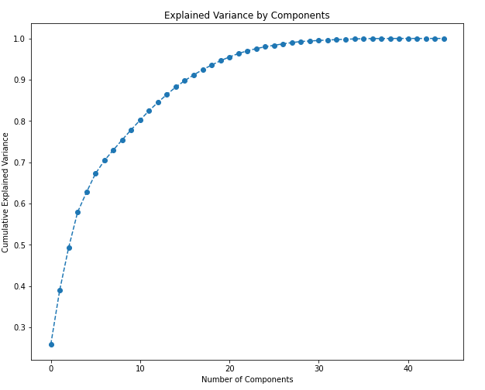
When doing K-Means, it is important that our model is as interpretable as possible. One way we can improve interpretability is through dimensional reduction techniques such as PCA (Principal Component Analysis). The goal of PCA is to identify patterns in a data set, and then reduce the dimensionality of the data while retaining as much as possible variation in the original dataset.
The plot below shows the explained variance by the number of components. A good rule of thumb is to still have roughly 80% of the total variance retained, so the best number of components we should keep is 10.
PCA: Principal Component Analysis

Slide 24
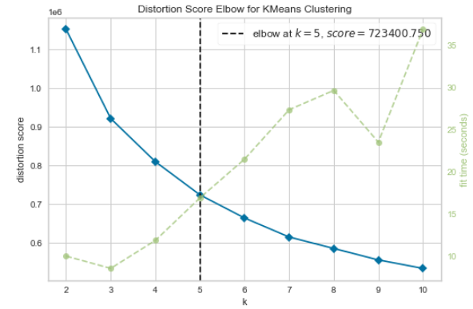
For our analysis, we do not want more than 5 groups as it would be inefficient for the campaign. Let us use the Elbow Method to determine how many clusters we should use.
Based on the plot below, the optimal number of clusters should not be more than 5, and it is obvious as the plot shows the optimal number is exactly 5 clusters. 5 clusters will allow us enough variety between the groups while also allowing us to not be inefficient to the marketing campaign with having the maximum number of groups.
K-Means: Determining Number of Clusters

Slide 25
from sklearn.metrics import silhouette_score
Group 1:
- No Saving Account
- No Guarantees
No Derivada Account
No Pensions_1
No Mortgage
No more than 4 total products
Employee index filial or not employee
Seniority less than 200 months
Group 2:
2 or more products
Not including 1 city
K-Means:
Results
Group 3:
No Junior Account
No more than 11 total products
Not including 2 cities
Ages 21, 20, 19 not included
Channels KHE and KHK not included
Group 4:
No Guarantees
No more than 8 total products
- All but 1 city
Group 5:
No Guarantees
No more than 6 total products
Not including 2 cities

Slide 26
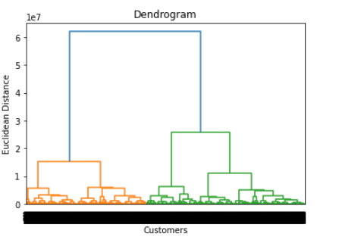
When determining the optimal number of clusters in Hierarchical Clustering, one way of doing so is through a cluster tree, or Dendrogram.
To find the optimal number of clusters, we first pick an area where the vertical distance between each linkage is the greatest. From the horizontal line below, the optimal number is 3.
Hierarchical Clustering:
Dendrogram for Determining Optimal Number of Clusters

Slide 27
Group 1:
Not including those with 12 total products
Employee Index not ex employed
Excluding 2 cities
Income less than 500k
Group 3:
No Guarantees
No more than 12 total products
Registered after 6 months
Excluding 6 cities
Income around 150k to 300k
Hierarchical Clustering:
Results
Group 2:
No Savings Account
No Guarantees
No Loans
Excluding those with 11 products
Employee Index not an employee
Registered after 6 months
Excluding many cities
Income greater than 250k

Slide 28
K-Means:
Pros:
Good for large data sets
Simple to implement
Cons:
Scaling with multiple dimensions
Lacks consistency
Sensitive to outliers
Agglomerative Hierarchical:
Pros:
- Hierarchy is easier to interpret the number of clusters than in K-Means
Cons:
Unable to cover very large amount of data, so you can only use a small percentage
Sensitive to outliers
Comparison
So, the best model choice for our analysis is K-Means since we are dealing with a very large amount of data (1 Million records, 40+ variables)

Slide 29
Based on the results from K-Means clustering and Hierarchical Clustering, we will be going with most of the results from the K-Means model. However, there are still a few recommendations based on our EDA and the Hierarchical model that could also be used in the splitting of customers into groups.
From the Hierarchical model, we did see that Income was a significant factor when dividing up customers, so maybe, we could have a couple groups that didn’t have Guarantees have income between 150,000 and 300,000.
We could also consider the time of registration as a couple groups from the Hierarchical model contained customers who registered after the first 6 months.
The bank could also focus maybe on other cities/provinces in Spain.
Final
Recommendation

Slide 30
Thank You

